Slide 1

<[GOD]>[
^[JESUS]^
WHAT TO DO NOW
These are some steps that I must begin
Without delay to take on a daily basis so
I will grow to be a giant in Christ.
<
GOD has done His part and will do all HE has to do to make me a victorious Christian ✝️ but I have got to do my own part faithfully.
>
[STEP ONE: PUT OFF THE OLD MAN]
Ephesians4:22

Slide 2
(That ye PUT OFF concerning the former conversation or manner of life the old man which is corrupt according to the deceitful lusts.)
Colossians 3:5-9
(Mortify therefore your members which are upon the earth; fornication, uncleanness, inordinate affection, evil concupiscence, and covetousness, which is idolatry:
For which things' sake the wrath of God cometh on the children of disobedience:
In the which ye also walked some time, when ye lived in them.
But now ye also put off all these; anger, wrath, malice, blasphemy, filthy

Slide 3
communication out of your mouth.
Lie not one to another, seeing that ye have put off the old man with his deeds;)
{ off the old man with his deeds.}
◇ These words make it plain that it is my duty to restrain my members from doing what I used to do in the past. That would be impossible for an unregenerate man to do but NOT for me. For the seed of GOD has come inside me at the time I became born-again. How do I then mortifying my members? It done not mean that I kill myself or cut my members off. Not at all. ◇
Romans 6:1014
(For in that he died, he died

Slide 4
unto sin once: but in that he liveth, he liveth unto God.
Likewise reckon ye also yourselves to be dead indeed unto sin, but alive unto God through Jesus Christ our Lord.
Let not sin therefore reign in your mortal body, that ye should obey it in the lusts thereof.
Neither yield ye your members as instruments of unrighteousness unto sin: but yield yourselves unto God, as those that are alive from the dead, and your members as instruments of righteousness unto God.
For sin shall not have dominion over you: for ye are not under the law, but under grace.)

Slide 5
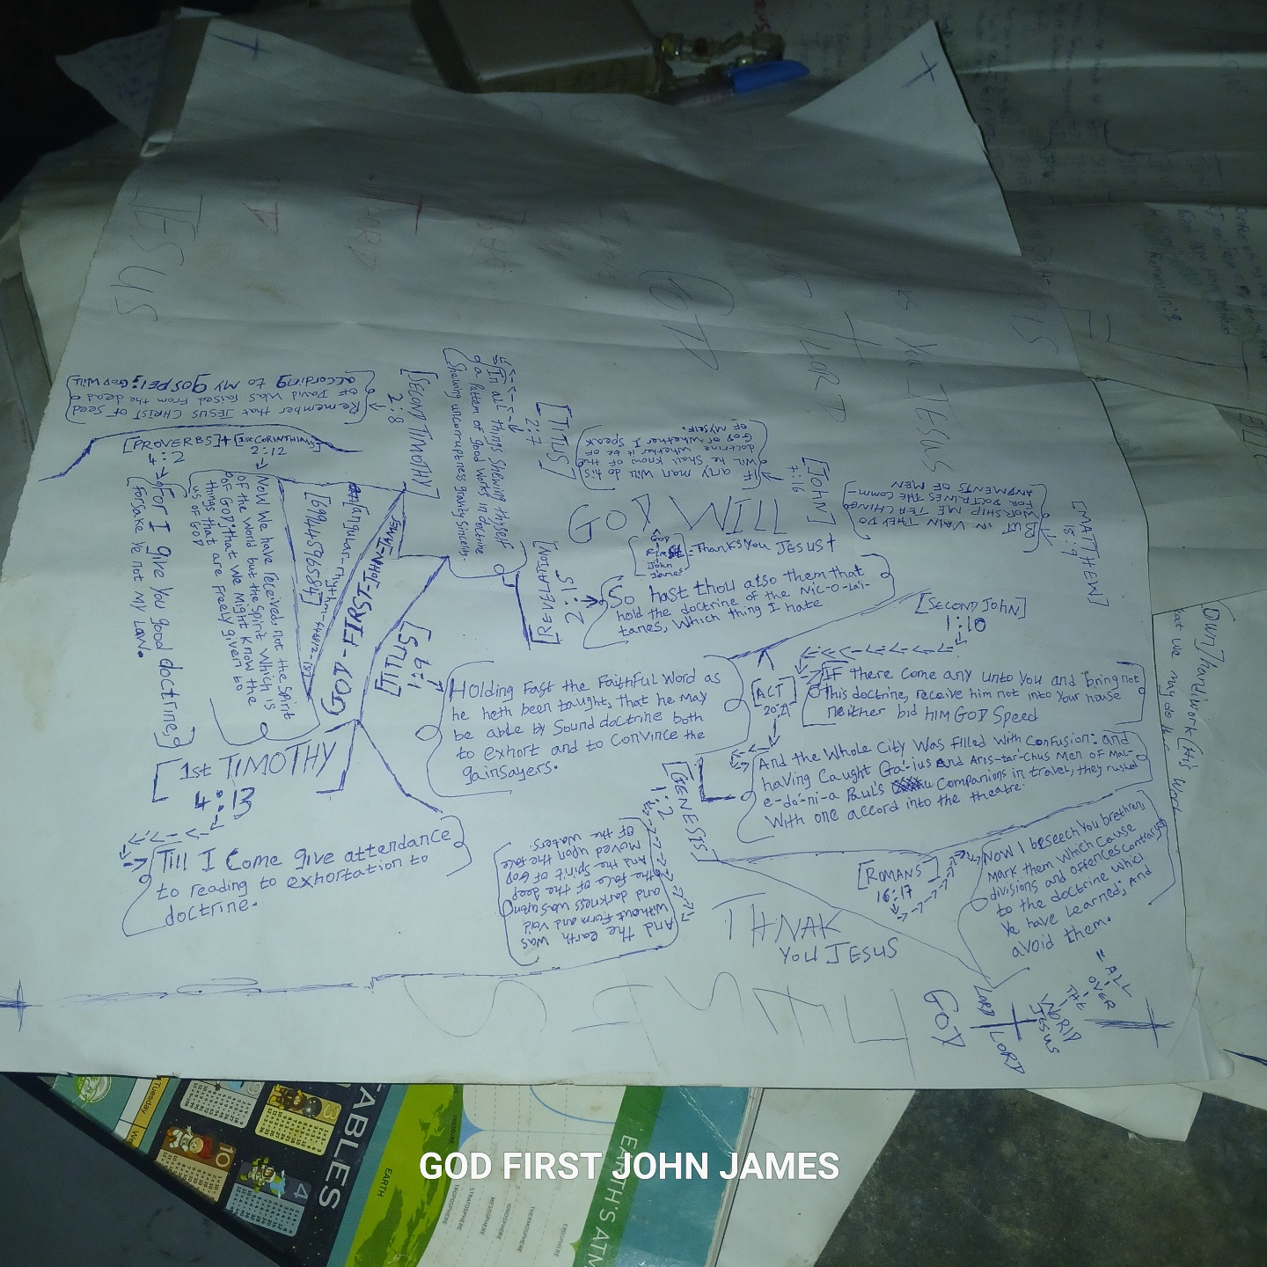
There are THREE WORDS I want myself notice and focus on in this passage. They hold the key to putting off the old man.
(@) REVKON
(b) LET
(C) PRESENT
*The three words place the responsibility squarely on my shoulders.*
^Let me examine each one.^
■ RECKON: To reckon means to count or assume

Slide 6
It involves my will and it is two-fold reckoning.
First RECKON MYSELF DEAD TO SIN.
There is a difference between 'dead in sin' and 'dead to sin' An unregenerated man is 'dead in sin' Let JESUS CHRIST help me a little: Suppose there is a dead man's body lying on the ground; and a fly began to hover around the ear of that body; will the body respond to the presence of the fly? Certainly not! That body is dead to the fly. The fly CAN NOT get a response from that body. Can that body (because it cannot respond to the fly) claim the fly is not existing. No, since the man is dead. Logic-understand-by-me°
Sin, like that fly, is not supposed to get any

Slide 7
response or reaction from me because I have legally died with Christ. The only way sin in actual life situation will not get any reaction from Me is by a CONSIOUS RECKONING OF MYSELF AS DEADTO SIN. Not that I reckon myself dead to people but to sin or the temptation to sin. But this reckoning cannot s u c c e e d u n l e s s I a d d to it t h e C O M P L E M E N T A R Y R E C K O N I N G O F MYSELF AS LIVING TO GOD!
*
If as there is the temptation of Satan to sin, there is the prompting of GOD to holiness. I are now to consciously reckon myself or consciously make myself available or open to the prompting of GOD to holiness.
1 Corinthians 10:13
(There hath no

Slide 8
temptation taken you but such as is common to man: but God is faithful, who will not suffer you to be tempted above that ye are able; but will with the temptation also make a way to escape, that ye may be able to bear it.)
DO I SEE IT? The way of escape is always there anytime I was tempted BUT I have to take that way of escape. GOD WILL not force it on me. What it means is: I don't have to yield to the temptation. It is not wrong to be tempted but it is not only wrong not to take the way of escape provided but to yield to the temptation is very foolish and beneath my new status in CHRIST.■
^......^
■ LET: This is to say, the right to permit

Slide 9
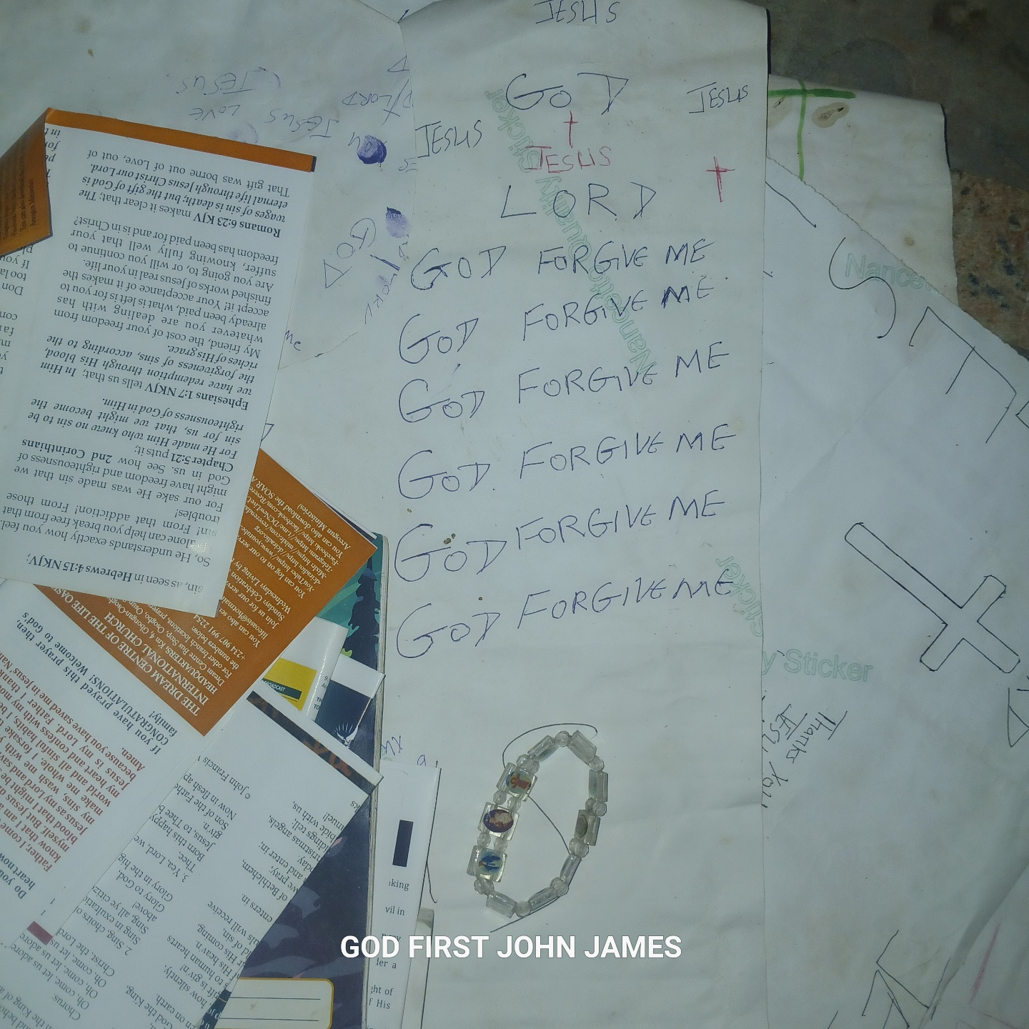
or allow either righteousness or sin to reign in my body is mine. Do not ALLOW that temptation to gain a foothold in my mind or emotions.
■
^****^
PRESENT: Look at this world🌎. It connects an act of presentation. I present or yield my members to GOD as consciously as I reckon them dead to sin and alive to GOD. It is a question of my Will. My Will to present my members to GOD for HIM to use for righteous action. What JESUS means is this:

Slide 10
I DON'T REALLY HAVE TO LOOK AT THAT SIGHT THAT IS TEMPTING I NOW NOR DO I NEED TO LISTEN WITH MY EAR TO THAT GOSSIP OR MUSIC! I can then present my eyes to GOD to look at another wholesome sight. Let JESUS give me two examples in the Bible:
Job 31:1
<I have made a covenant with my eyes, why them should I look intently upon a young woman?>
Psalm 101:3a
<I will set no wicked things before my eyes...>
I see, it is a question of choice. I choose to present those members of my body to GOD.

Slide 11
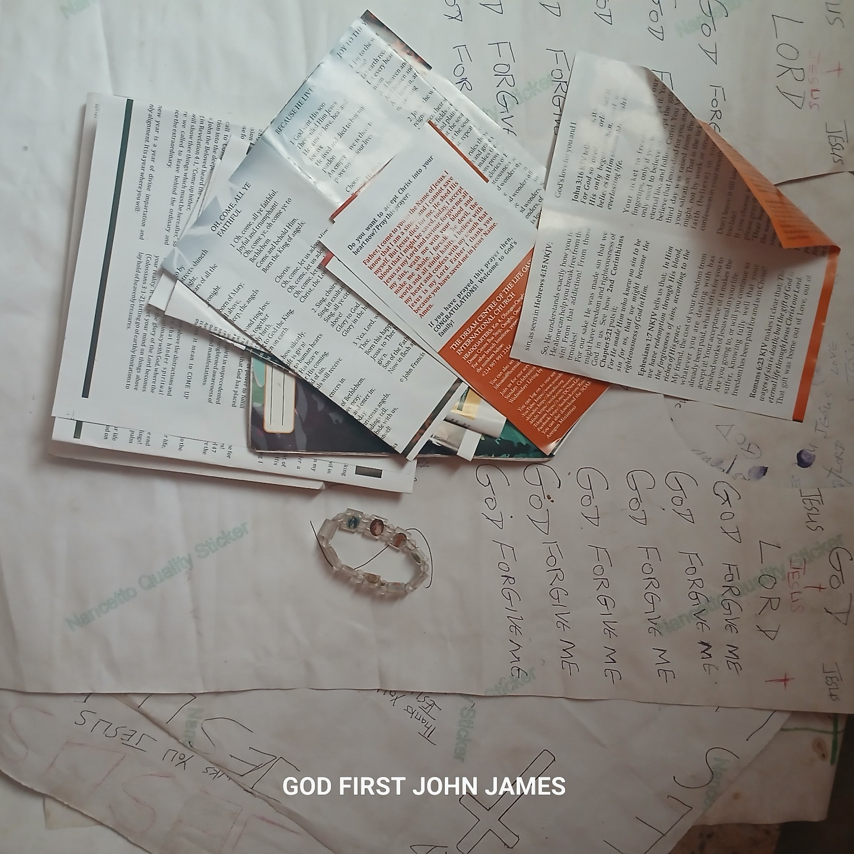
I have got to make a clean break with ALL that I know to be sinful. All sinful relationships and associations of the past have got to be done away with.

Slide 12


Slide 13

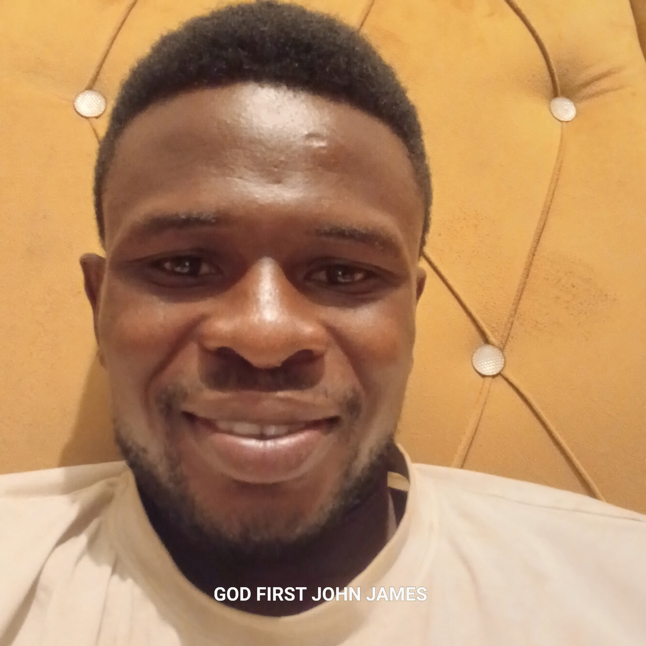

Slide 14
]

